Slide 1
Role of Political Parties (1 of 2)
Democratic and Republican parties integral to Texas governmental process.
Party identification significantly influences political preferences and behaviors.
Party identification is a psychological attachment shaping how individuals view issues and vote.

Slide 2
Role of Political Parties (2 of 2)
Political parties are defined as groups aiming to control government through elections (Duverger’s Law explains why Single Member District systems favor a two-party structure).
Parties recruit and elect candidates, essential for Texas democracy.

Slide 3
Political Ideology
Political ideology can be defined as a collection of beliefs about the appropriate order of society and how to achieve it.
Ideology influences political party alignment.

Slide 4
Political Ideology Conservatism
Conservatism advocates minimal government intervention in the economy.
Fiscal conservatives prioritize tax/spending cuts
Social conservatives emphasize traditional values (e.g., opposing abortion, marriage equality).
The populist right opposes immigration and criticizes government and economic systems.

Slide 5
Political Ideology Liberalism
Liberals favor government regulation for equitable wealth distribution and minimal intervention in personal lives (e.g., supporting marriage equality, civil rights).
The progressive left advocates for expanding social safety nets, increasing taxes on businesses/wealthy, and promoting equal rights for underrepresented groups.

Slide 6
Political Ideology Beyond Liberal and Conservative: Thinking About Ideology
Texas political ideology extends beyond liberal/conservative, with some Republicans favoring libertarianism’s minimal government intervention in both economic and social issues.
Moderates take middle-ground positions, and Latino Americans often combine economic liberalism with social conservatism.
Libertarianism is the ideology for those who believe in a minimal role for government in economic matters and social issues.

Slide 7
Electoral Trends
Texas politics is shaped by evolving issues (e.g., civil rights, immigration) and demographics (e.g., growing Latino, Black populations).
Texas shifted from Democratic (pre-1970s) to Republican dominance (1994–present), with Democrats strong in urban areas (e.g., Harris, Bexar).
Republican dominance continued in 2022/2024, with Democrats losing Latino support in the Rio Grande Valley.
Straight-ticket voting, eliminated in 2020, historically amplified partisan outcomes.

Slide 8
Electoral Trends Third Parties
Third parties (e.g., Green, Libertarian) influence major parties but rarely exceed 3% of votes (e.g., 2024: Jill Stein 0.73%, Chase Oliver 0.6%).
Historical impact from Populist Party (1890s) and La Raza Unida (1970s).
2019 law (HB 2540) lowered ballot access threshold to 2% but added filing fees/signatures.
Social media aids cost-effective third-party campaigning (e.g., Green Party’s Bexar County Facebook post).

Slide 9
Electoral Trends Independent Candidate
Independent candidates face challenges in campaigning, fundraising, and ballot access (e.g., 81,029 signatures required in 2024).
No independent has won Texas governorship since Sam Houston in 1859.
In 2006, independents Carole Keeton Strayhorn (18%) and Kinky Friedman (14%) ran but lost to Rick Perry (39%).

Slide 10
An Overview of Texas Political History 1840s to 1870s: The Origin of the Party System
Texas politics initially hinged on personalities, not parties.
Post-Union admission, White Texans strongly supported Democrats.
Republicans ruled Texas during Reconstruction, appointing party members.
After Davis's 1873 defeat, no Republican governor for 100+ years.

Slide 11
An Overview of Texas Political History 1870s to 1970s: A One-Party Dominant System
Post-Reconstruction to 1970s, Texas was Democratic-dominated, with 52 consecutive gubernatorial wins.
Populist Party (1890s) influenced Democrats on agricultural issues.
Democrats split into conservative (pro-business) and liberal (New Deal) factions.
Republicans gained support with Eisenhower’s presidential wins (1952, 1956) and John Tower’s Senate victory (1961).

Slide 12
An Overview of Texas Political History 1970s to 1990s: An Emerging Two-Party System
1970s: Latino (Viva Kennedy Clubs, La Raza Unida) and Black activism strengthened Democratic liberals.
Post-Voting Rights Act, Black Texans’ participation increased.
Republicans gained with Bill Clements’ 1978 gubernatorial win and Kay Bailey Hutchison’s 1993 Senate victory.
Democrats saw diverse wins: Raul Gonzalez (1986, Supreme Court), Ann Richards (1990, Governor), Dan Morales (1990, Attorney General).

Slide 13
An Overview of Texas Political History 2000 to 2016: Republican Dominance
2000–2016: Republicans dominated, with George W. Bush’s 2000 presidential win and Rick Perry’s governorship.
2002: Democratic “dream team” (Tony Sanchez Jr., Ron Kirk, John Sharp) failed to win statewide offices.
2003 redistricting favored Republicans, leading to a majority in Congress (2005) and state legislature.
Obama carried urban counties (Harris, Dallas, Bexar, Travis) in 2008 and 2012 but lost Texas.

Slide 14
An Overview of Texas Political History 2016 to 2020: Democratic Optimism
Texas was one of the few states that voted more Democratic in the 2016 presidential election compared to 2012.
The 2018 midterm election brought national attention to Texas as Beto O’Rourke mounted a strong challenge to incumbent Senator Ted Cruz.
Democrats aimed to expand their 2018 gains in 2020, targeting control of the Texas House, more congressional seats, and a potential Biden victory in the presidential race.

Slide 15
An Overview of Texas Political History 2022 to Today: Republicans Reassert Dominance
2022 (Beto O’Rourke, Governor) and 2024 (Colin Allred, Senate) losses showed continued Republican dominance.
Democratic support eroded among Latinos in the Rio Grande Valley (2024).
Younger Texans and people of color show Democratic potential, but 2023 macropartisanship declined.

Slide 16
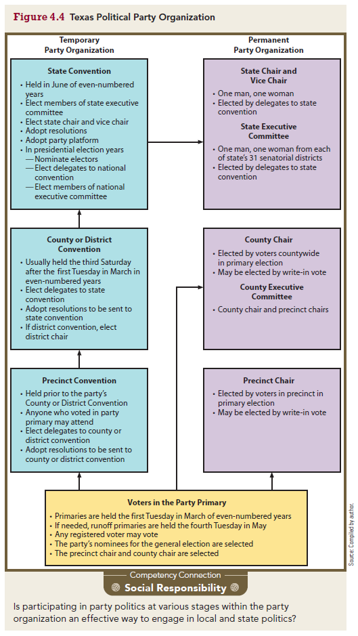
Party Structure
US parties exist on four levels: national, state, county, and precinct.
Power and authority are distributed among different levels within the organization (i.e., not a hierarchy)
As mandated by the Texas Election Code, Texas’s two major parties are alike in structure. Each has permanent and temporary organizational structures

Slide 17
Party Structure Temporary Party Organization (1 of 4)
Temporary party organization in Texas includes primaries and conventions.
State conventions select national convention delegates, nominate electors, and must be media accessible.
Parties adopt party platforms at state conventions.

Slide 18
Party Structure Temporary Party Organization (2 of 4)
Precinct Conventions
Precinct conventions, the lowest political organization level, adopt resolutions and select delegates.
Citizens affiliated with a party can participate in its precinct convention.
Democratic precinct conventions select state convention delegates.

Slide 19
Party Structure Temporary Party Organization (3 of 4)
County and Senatorial District Conventions
County and district conventions elect state delegates and adopt resolutions.
Delegates are chosen based on gubernatorial votes; Democrats ensure diverse representation.

Slide 20
Party Structure Temporary Party Organization (4 of 4)
State Conventions
Biennial Texas state conventions draft party rules, adopt platforms, and select national delegates in presidential years.
2024: Democratic Convention (June 6–8, El Paso); Republican Convention (May 23–25, San Antonio).
Republicans passed a rule preventing censured candidates from primary ballots for two years.
Texas has 40 electoral votes (2024, based on 38 representatives + 2 senators).

Slide 21
Party Structure Selection of National Convention Delegates
Democratic Selection
Delegates selected based on presidential preference primary results.
Democrats allocate delegates proportionally (2024: 264 pledged, 74 automatic; Kamala Harris won 263/264 Texas delegates).
Republican Selection
Republicans award delegates for candidates above 20% statewide or 50% per district (2024: 161 delegates, all for Trump).

Slide 22
Party Structure Permanent Party Organization
The permanent party organization involves precinct chairs, county and district executive committees, and a state executive committee.
Precinct Chair
Registers voters, distributes info, and runs phone banks.
County and District Executive Committees
Manage local conventions and campaigns.
State Executive Committee
Manages statewide strategy and candidate recruitment.

